Slide 1
Software Requirements Specification Car rental Prepared by Supervised by Md. Abdul Motin Md. Rajaul Islam ID : 1246494 Round : 39 Used Technology Java Jsf, PrimeFaces, Hibernate, Jdbc, Netbeans & Mysql

Slide 2
Requirements Hertz car rental service in BD take you through an amazing journey while providing you with the flexibility of exploring this diverse nation at your own pace. We have our car hire outlets located at all the major location in BD making it really convenient for our clients to pick up their chosen car. We also offer special services to our clients such as Hertz Never Lost - In-Car Navigation, SiriusXM Radio, emergency roadside assistance and services for people with disabilities. Our car hire in BD is a tremendous way to explore and enjoy your stay, no matter how short or long.

Slide 3
Requirement analysis User list Customer list Customer registration. Vehicle registration. Proper Service. Paid Bills. Report summary.

Slide 4
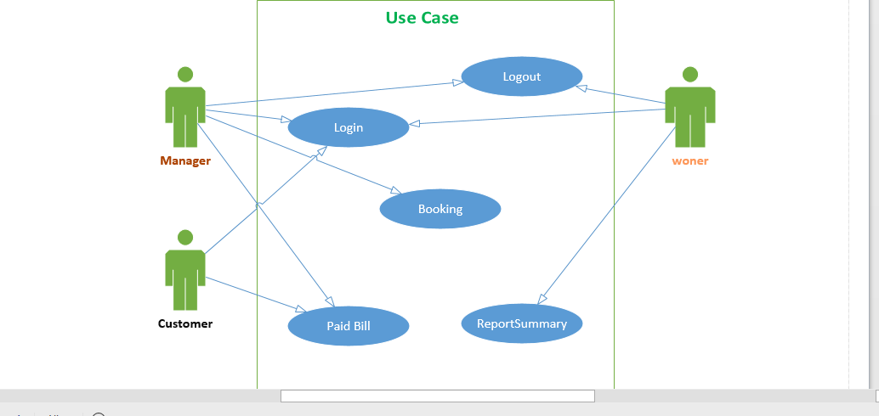
Use Case Diagram

Slide 5
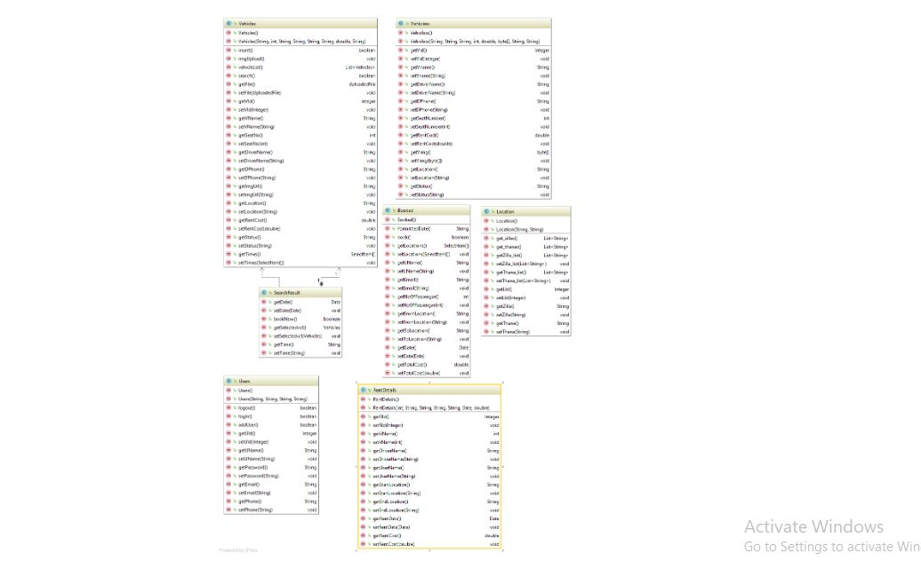
Class Diagram

Slide 6
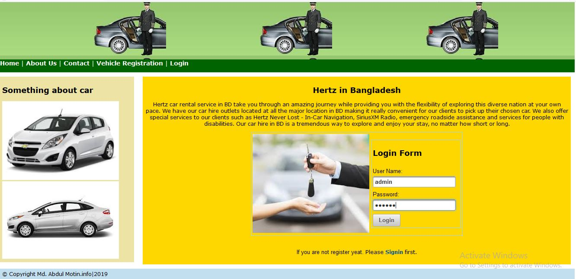
login

Slide 7
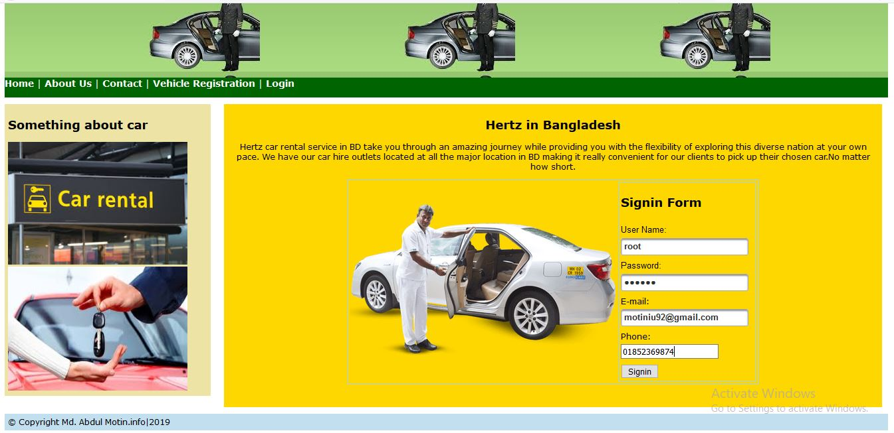
signing

Slide 8
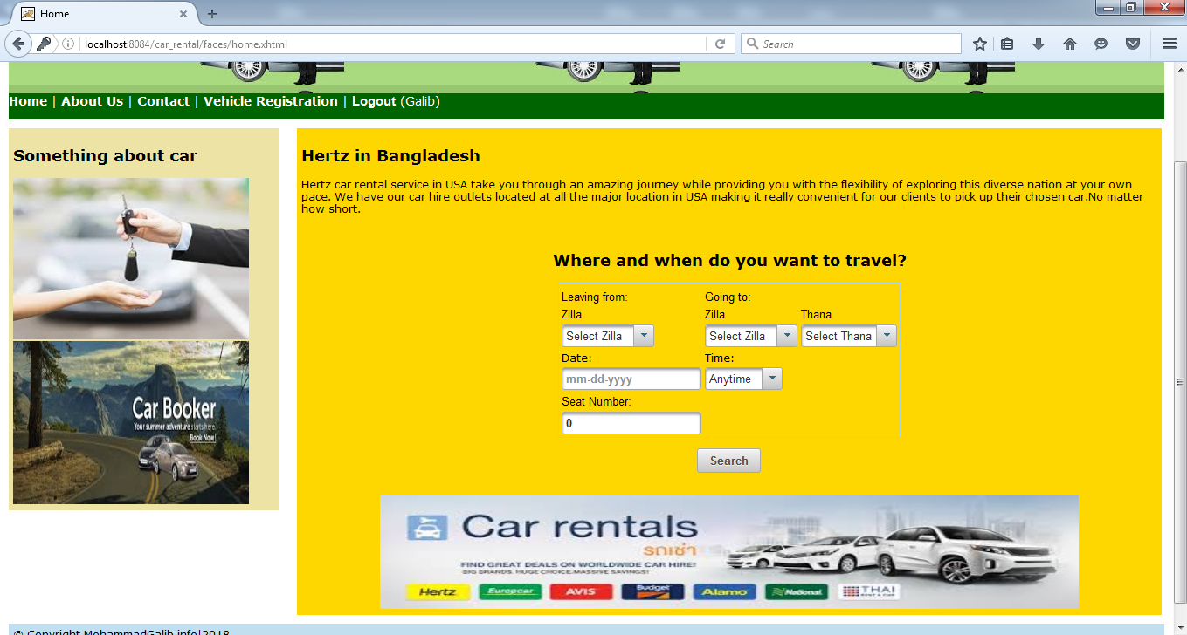
Home Page

Slide 9
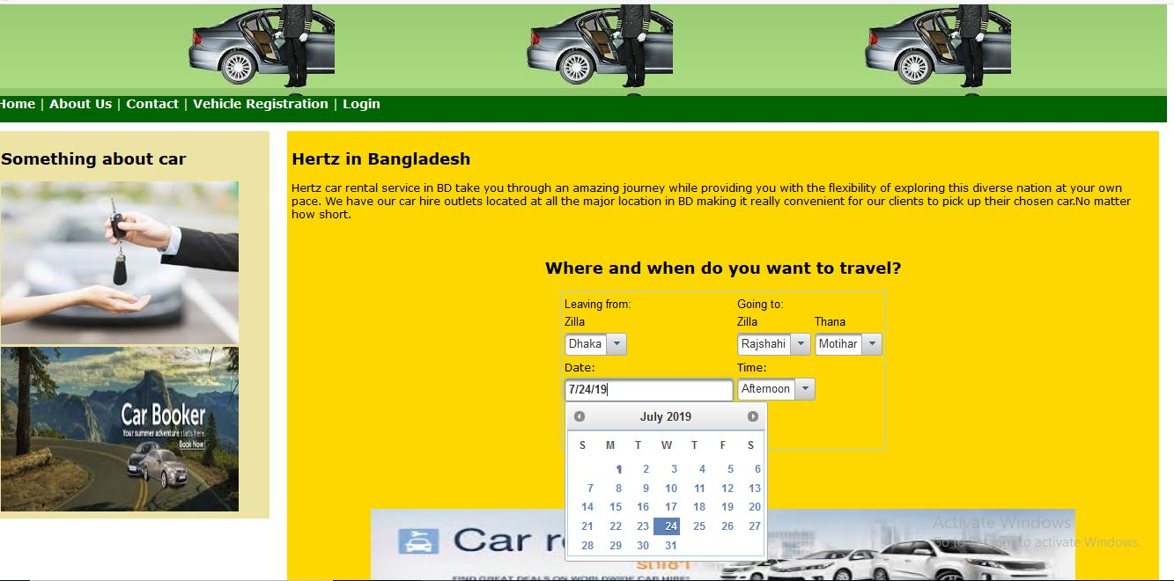
home2

Slide 10
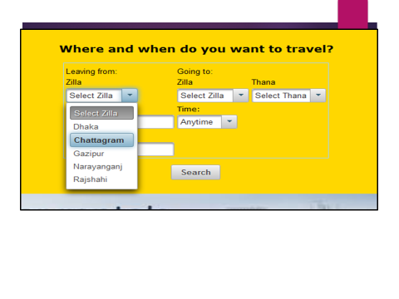

Slide 11
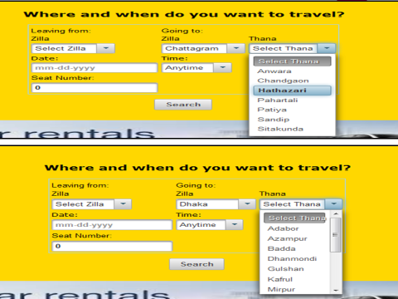

Slide 12
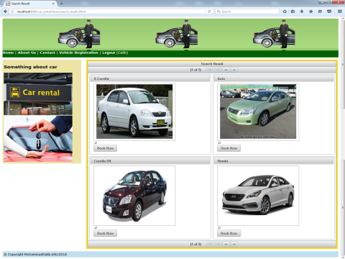

Slide 13
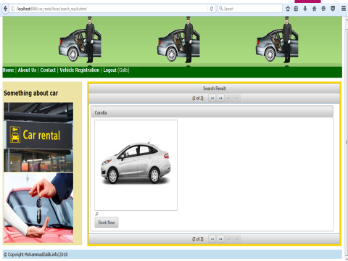

Slide 14
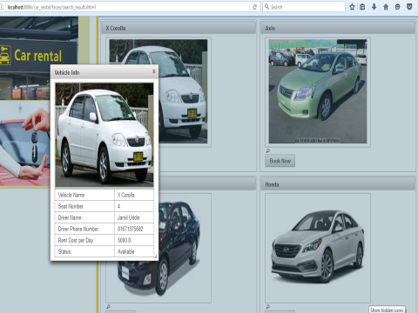

Slide 15
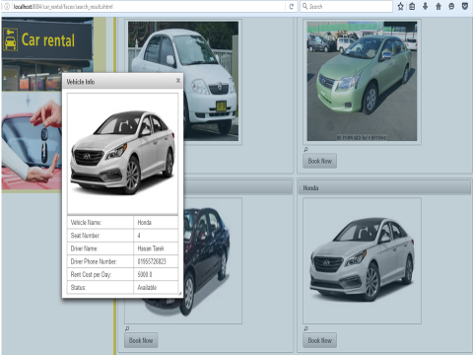

Slide 16
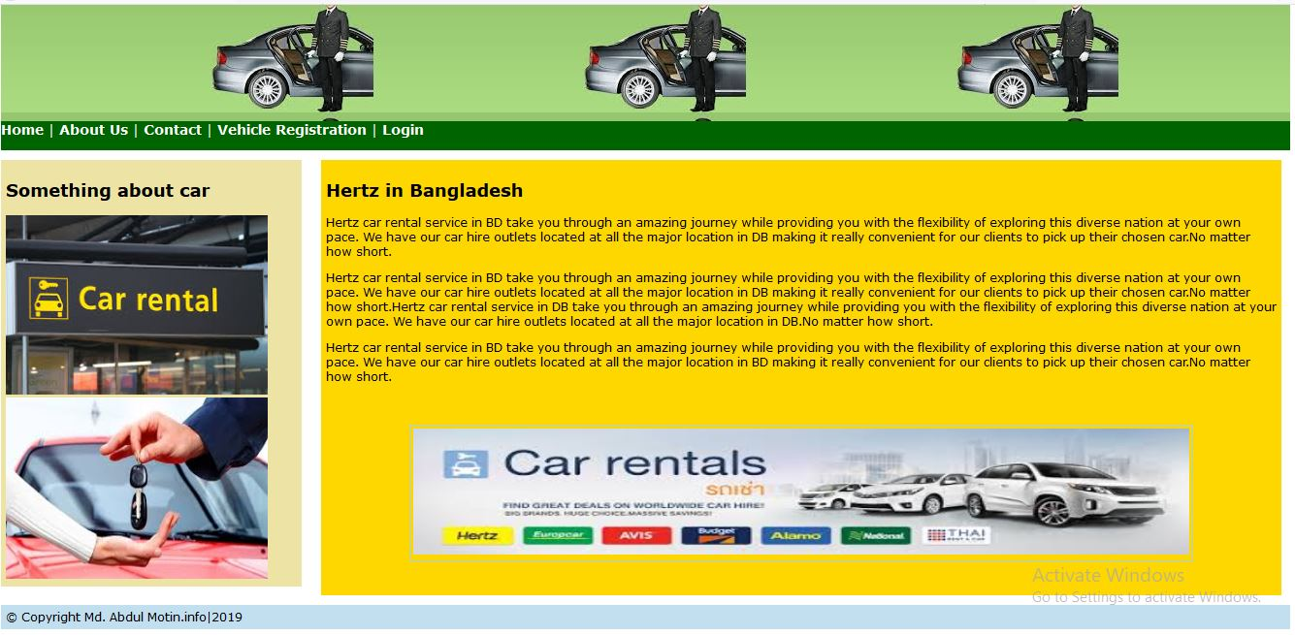
About

Slide 17
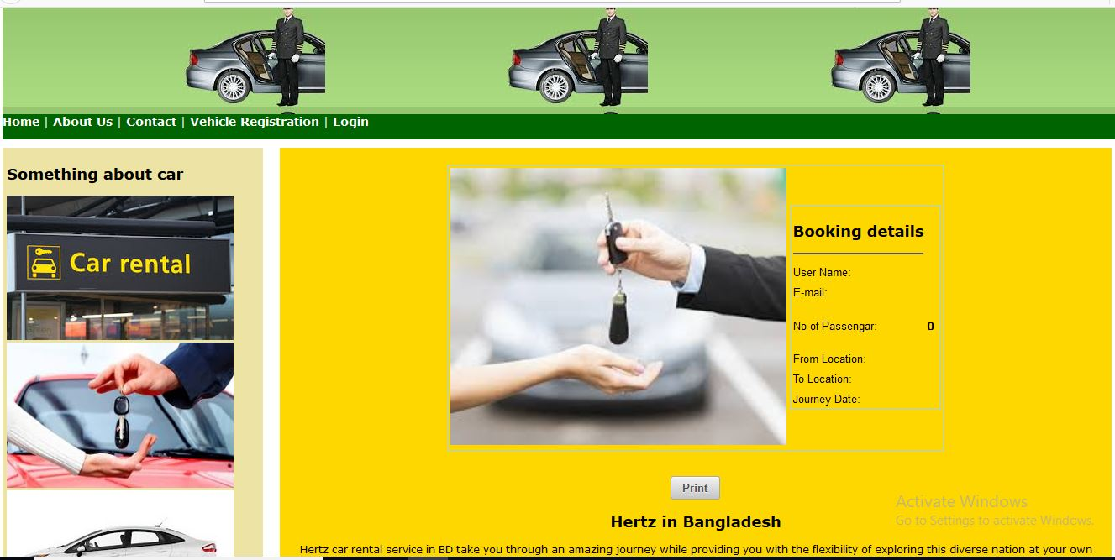
Booking

Slide 18
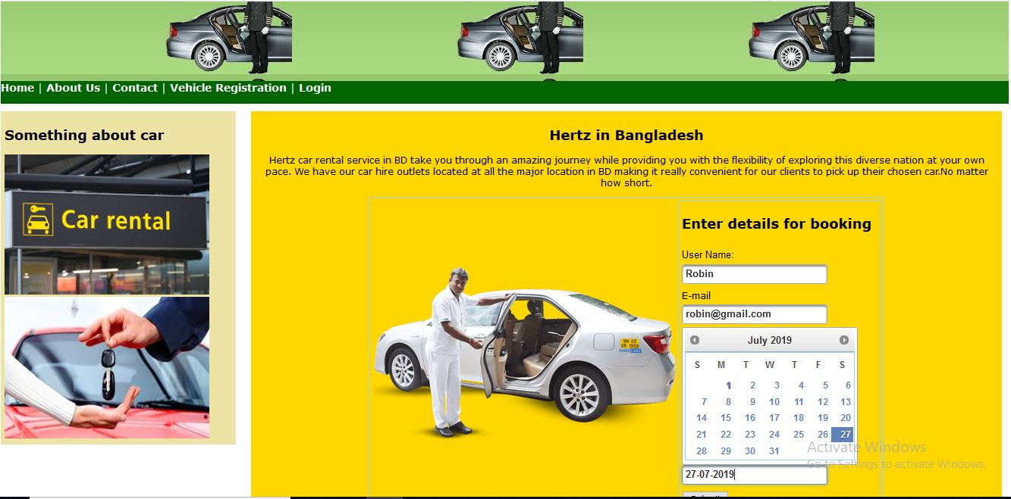
Booking2

Slide 19
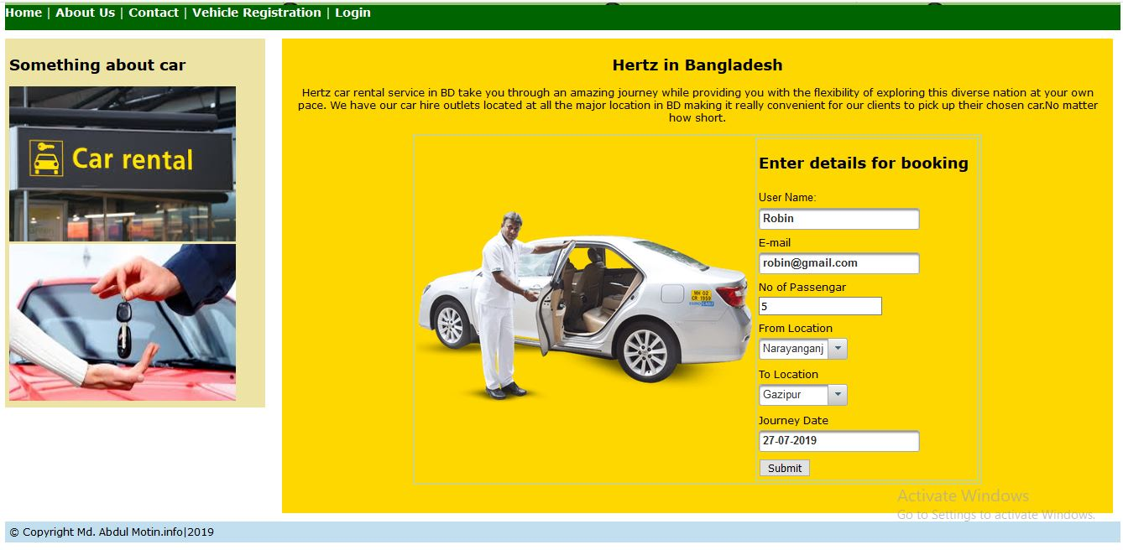
Booking details

Slide 20
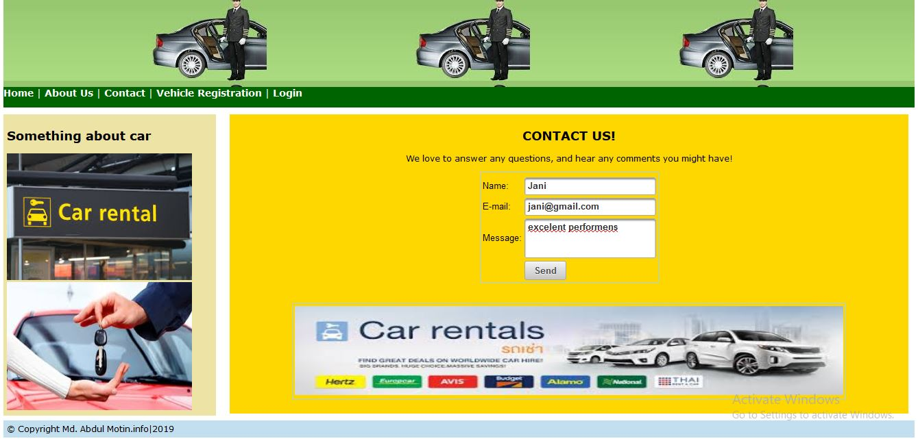
contact

Slide 21
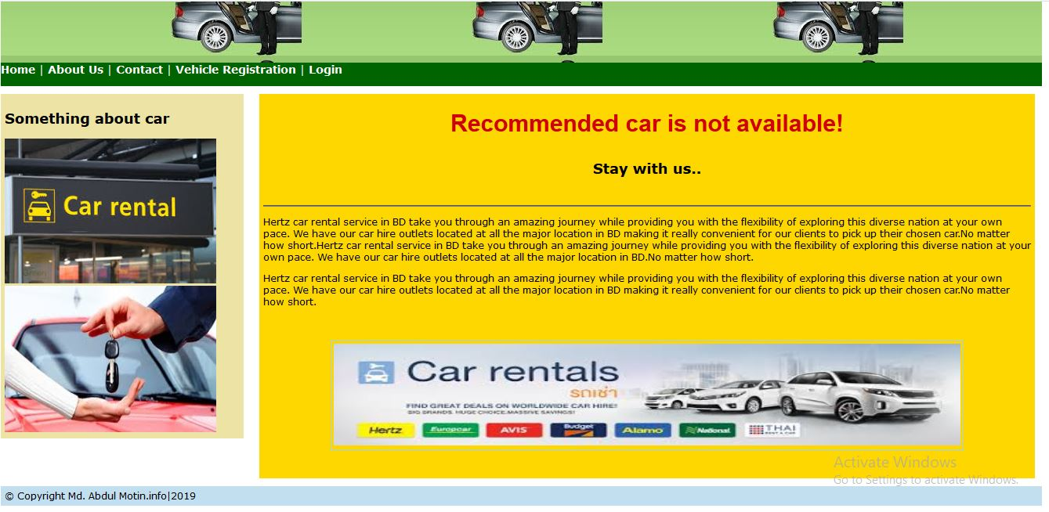

Slide 22
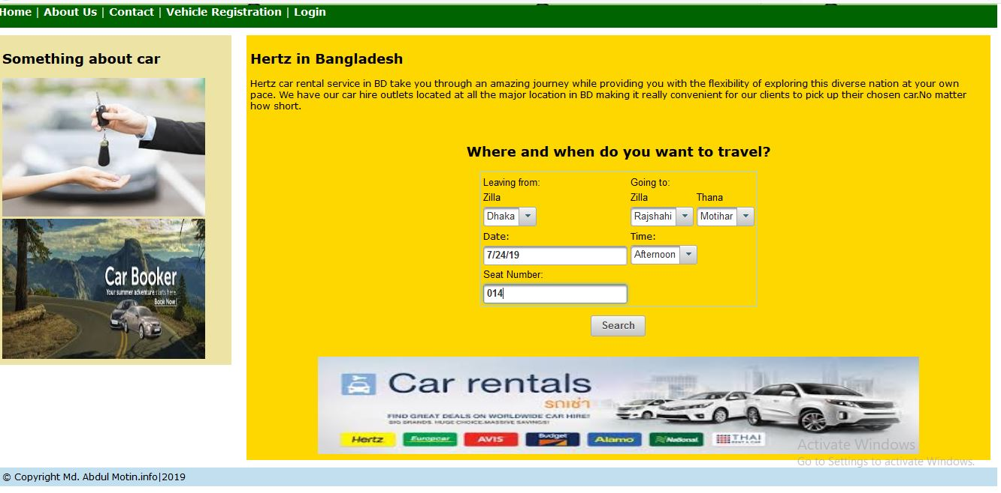

Slide 23
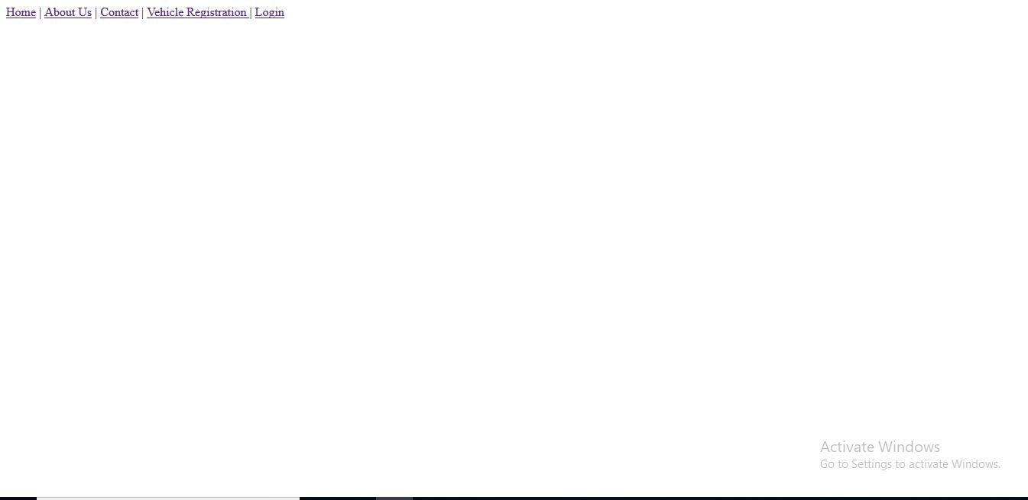
menu

Slide 24
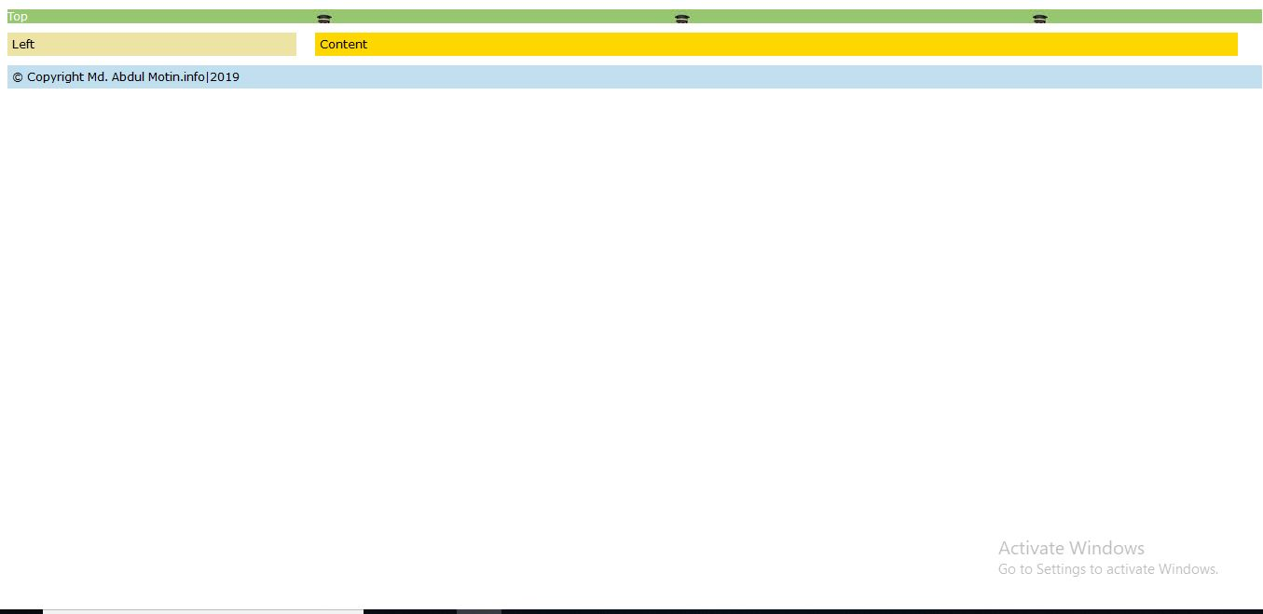
Template

Slide 25
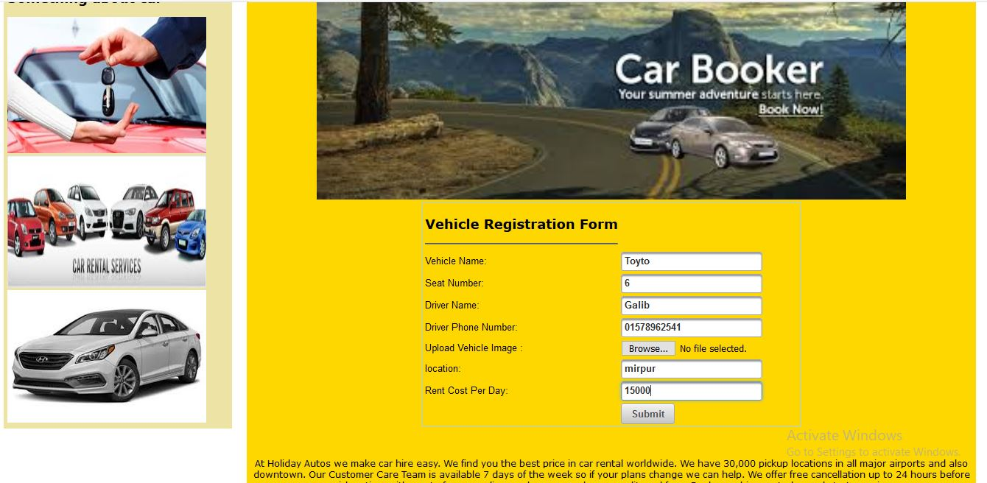
Vehicle Registration

Slide 26


